Slide 1

Acute, Subacute, and chronic diseases
Guy Arnold
Field Service Officer
South Dakota Department of Veteran Affairs

Slide 2
Overview
Acute, Subacute, and Chronic Definitions
Rheumatoid, Degenerative Arthritis and Fibromyalgia Conditions
4.71 Schedule of Ratings – Musculoskeletal System (Diagnostic Codes DC 5000 – 5025
Service Connections

Slide 3
Definitions
Acute: Acute is the medical term to describe the nature of a disease, sign, symptom or condition. It refers to an illness that is of a sudden onset or of a short duration. Acute can also be used as an adjective to describe a severe state of a condition. Often the term acute is used in contrast to the medical term chronic. In this case the difference lies between an illness that is short lived (acute) compared to an illness that is long term or persistent (chronic). Acute pain refers to pain that may have come on suddenly and is only present for a few days or even weeks. If the pain persists and is ongoing, it will be considered as chronic.

Slide 4
Subacute: Another medical term related to acute is subacute. This means that the symptom or illness is not yet chronic but has passed the acute phase. It may also indicate that the condition is not as severe as the acute stage. Acute, subacute and chronic may be used as a reference to time where acute refers to a condition that is present for less than 1 month, while subacute denotes a condition that is persisting for 1 to 3 months.

Slide 5
Chronic: Chronic refers to any condition, disorder or disease that is ongoing. It is often thought to be permanent and while many chronic diseases are permanent, some can eventually resolve and disappear altogether. More correctly, chronic refers to a time frame of 3 months or more. However, this time frame may be shorter is some cases. Chronic conditions do not necessarily have to always persist. In other words, the symptoms may not be present constantly. With some chronic conditions, the symptoms essentially come and go. This means it goes through active stages and periods of remission.

Slide 6
Conditions
Rheumatoid Arthritis: Rheumatoid arthritis occurs when the immune system malfunctions and attacks the membranes lining your joints causing inflammation and resulting in limited motion, stiffness, or pain. Both conditions can cause pain and symptoms may range from mildly disabling to debilitating.

Slide 7
Rheumatoid Arthritis under diagnostic code 5002
Rheumatoid arthritis disability rating can change throughout your lifespan because the intensity of the arthritis may worsen. Rheumatoid arthritis is also rated depending on the joints involved yet can only be rated as either an active condition or for residual chronic conditions.
Under Diagnostic Code 5002, the VA rates your rheumatoid arthritis case based on the following:
100%: The veteran’s rheumatoid arthritis results in incapacitation. Multiple organs and body systems are affected along with your joints.
60%: The veteran has severe incapacitating episodes four or more times per year. Episodes are accompanied by anemia, weight loss, and decreased overall health.
40%: The veteran has three or more incapacitating episodes per year or a medically diagnosed health condition and day-to-day impairment.
20%: The veteran has one-to-two or more incapacitating episodes per year and has a well-established diagnosis.

Slide 8
Rheumatoid Arthritis under diagnostic code 5002 Continued
A 10% rating may be applied for effects such as swelling, muscle spasms, or experiences of pain while moving if they are separate from conditions under Diagnostic Code 5002.

Slide 9
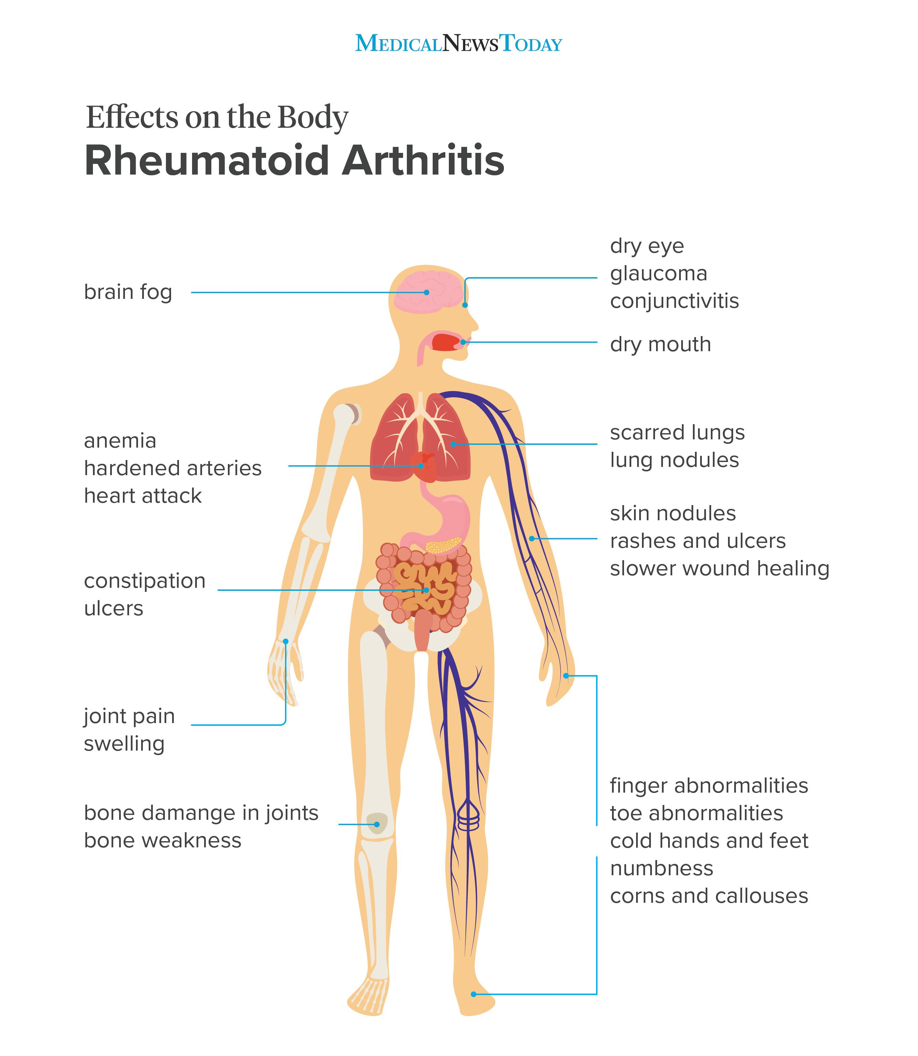
Some of the effects to the body

Slide 10
Degenerative Arthritis: Degenerative arthritis is also referred to as osteoarthritis. It can also be called “wear and tear” arthritis and is the most common form of arthritis.

Slide 11
Degenerative arthritis under diagnostic code 5003
Degenerative arthritis VA rating is based on the number of joint/joint groups that have a limited range of motion. This is often determined via X-rays. If there is a limited range of motion, but arthritis does not show up on the X-ray, there is an automatic 10% rating for each major or minor joint group affected.
The osteoarthritis disability ratings are either 10% or 20% depending on the following symptoms:
10%: a veteran has degenerative arthritis in two or more major joints, or two or more groups of minor joints seen with X-ray evidence.
20% through X-ray evidence along with occasional incapacitating exacerbations.

Slide 12
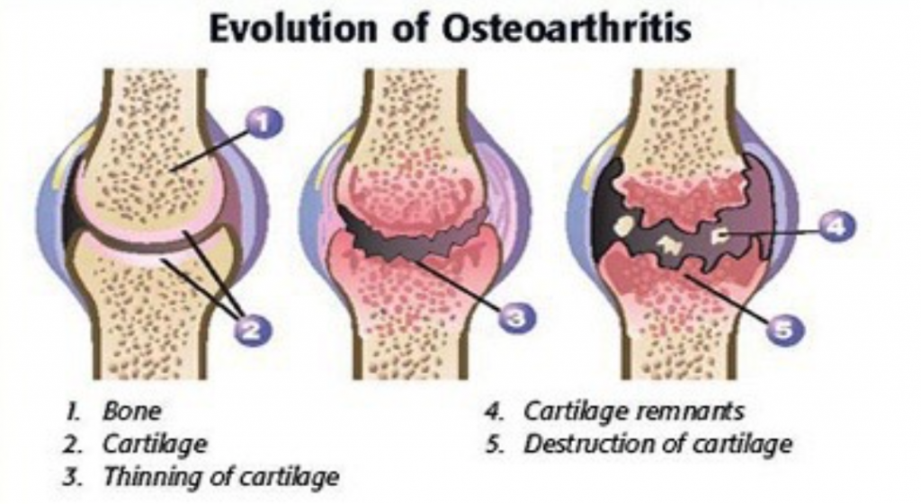
The wear and tear

Slide 13
M21-1 degenerative Arthritis
Degenerative arthritis is evaluated using 38 CFR 4.71a, DC 5003. Degenerative arthritis can affect multiple joints, and its cause is likely multi-factorial. When 38 CFR 4.71a, DC 5003 is assigned for an arthritic condition, every joint or group of joints affected by this disease is subject to service connection (SC) in the absence of an intervening cause.
If it has been medically determined that the Veteran has service-connected (SC) degenerative arthritis, and not post-traumatic arthritis, there is no need for a medical opinion to establish SC for each affected joint.
Once degenerative arthritis has been clinically diagnosed and SC has been properly established for one affected joint, establish SC for and evaluate each joint as it becomes affected, with x-rays used to verify involvement of individual joints.
Note: In evaluating arthritis of the spine, the principles for establishing SC for joints affected by the subsequent development of degenerative arthritis (as contemplated under 38 CFR 4.71a, DC 5003) are not dependent on the choice of DC. Example: Veteran is SC for degenerative arthritis of the spine under 38 CFR 4.71a, DC 5242, and subsequently develops degenerative arthritis in the right elbow, with no intercurrent cause noted. In this case, the principles of establishing SC for arthritic joints, as contemplated in 38 CFR 4.71a, DC 5003, also apply even though the Veteran is rated under 38 CFR 4.71a, DC 5242. Thus, SC for arthritis of the right elbow may be established. References: For more information on
major and minor joints affected by arthritis, see
  38 CFR 4.45(f), and
  M21-1, Part III, Subpart iv, 4.A.2
degenerative arthritis, see MEPSS
considering x-ray evidence when evaluating arthritis and non-specific joint pain, see
  38 CFR 4.71a, DC 5003, and
  M21-1, Part III, Subpart iv, 3.D.4.h, and
distinguishing between degenerative and traumatic arthritis, see M21-1, Part III, Subpart iv, 4.B.3.

Slide 14
Fibromyalgia: Fibromyalgia is a condition characterized by widespread musculoskeletal pain usually accompanied by sleep, memory and mood issues, and fatigue. For the pain to be considered widespread, it must be on both the right and left sides of the body and both above and below the waist.

Slide 15
Fibromyalgia under Diagnostic code 5025
diagnostic code 5025 lists the VA’s rating criteria for fibromyalgia and includes ratings from 10% to 40% disabling. Each rating begins with the prerequisite that there be “widespread musculoskeletal pain and tender points, with or without associated fatigue, sleep disturbances, stiffness, paresthesia's, headache, irritable bowel syndrome, depression, anxiety, or Raynaud’s-like syndrome.” From there, each rating has its own requirements.

Slide 16
Fibromyalgia under Diagnostic code 5025 continued
10%: Requires that the veteran take continuous medication for the control of their fibromyalgia.
20%: The VA requires that the symptoms be “episodic, with exacerbations often precipitated by environmental or emotional stress or by overexertion, but that are presented more than one-third of the time.
40%: the highest VA rating for this condition, the veteran’s symptoms must be “constant, or nearly so, and refractory to therapy”.
Note: Veterans of the Persian Gulf War who develop fibromyalgia may be entitled to service connection. Under the VA’s regulation for qualifying disabilities for Persian Gulf War veterans, fibromyalgia is “a medically unexplained chronic multisymptomatic illness that is defined by a cluster of signs or symptoms.

Slide 17
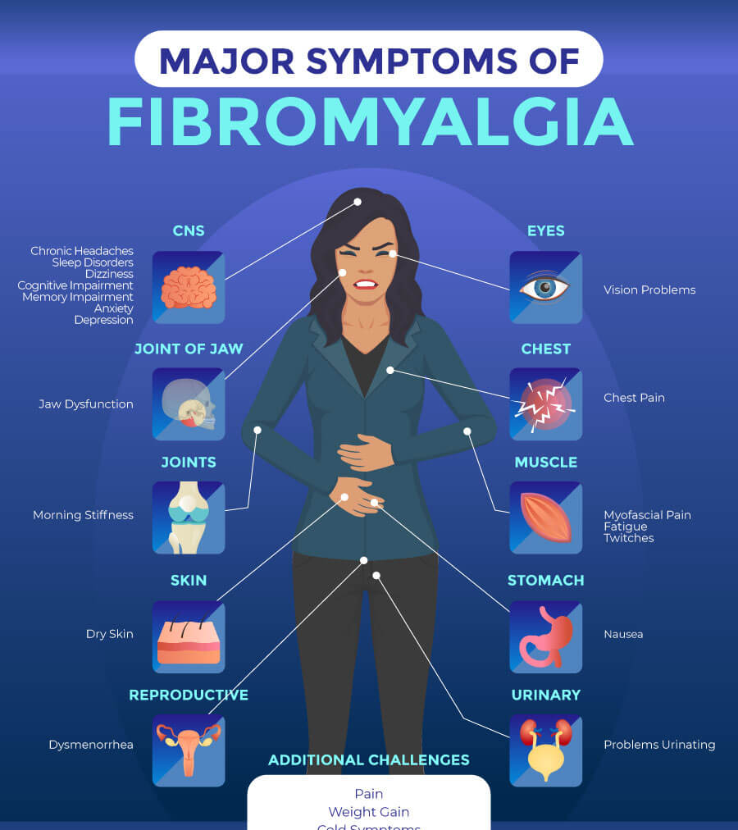
The Major symptoms

Slide 18
Direct Service Connection
This is where recording your injuries throughout service will benefit you. Though there does not need to be a specific injury, in-service injuries and the overall overuse of your joints warrant the possibility of arthritis to develop later in life. To prove arthritis is service connected, a doctor may be able to determine that your history with injury in your service is likely to have caused arthritis. There still needs to be a VA disability rating for arthritis and if the VA sees a link, you may claim direct service connection.

Slide 19
Presumptive service connection
Both rheumatoid and degenerative arthritis are considered chronic diseases that are subject to presumptive service connection. Veterans may receive a 10% VA disability rating if arthritic symptoms appear within one year of service discharge. This service connection will be useful for making your VA claim for arthritis benefits, especially if there is no record of injury or overuse of joints during your service.

Slide 20
Secondary service connection
Arthritis may be a secondary condition as a result of another service-related disability. Under the Code of Federal Regulations, arthritis can be considered as service incurred if it is directly connected to the service-related injury. For example, if you have a service-connected knee injury and develop arthritis later in life caused by your injury, the arthritis is considered a secondary service connection. It is also possible that arthritis can cause secondary conditions like depression. If you do develop secondary conditions and the VA determines a connection, you may claim secondary service connection.

Slide 21
Rheumatoid Arthritis
DC Codes (Example)
5002 RHEUMATOID ARTHRITIS (ALSO CLAIMED AS LEFT SHOULDER TO INCLUDE
ROTATOR CUFF AND TENDONITIS, AND LEFT ELBOW CONDITION, LEFT KNEE MEDIAL LIGAMENT SPRAIN) [Predischarge Exam]
Service Connected, Gulf War, Incurred
Static Disability
20% from 11/01/2008 to 09/21/2018

Slide 22
Degenerative Arthritis
DC Code (Example)
5003-5292 LOW BACK STRAIN, OSTEOARTHRITIS
Service Connected, Peacetime, Incurred
Static Disability
10% from 05/01/1995

Slide 23
Fibromyalgia
DC Codes (Example)
5025 FIBROMYALGIA WITH FATIGUE AND IRRITABLE BOWEL SYNDROME
[Environmental Hazard in Gulf War/Undiagnosed Illness]
Service Connected, Gulf War, Presumptive
Static Disability
40% from 07/29/2010

Slide 24
Questions……….
Things to add?
THANK YOU!!!!!!!

